Slide 1
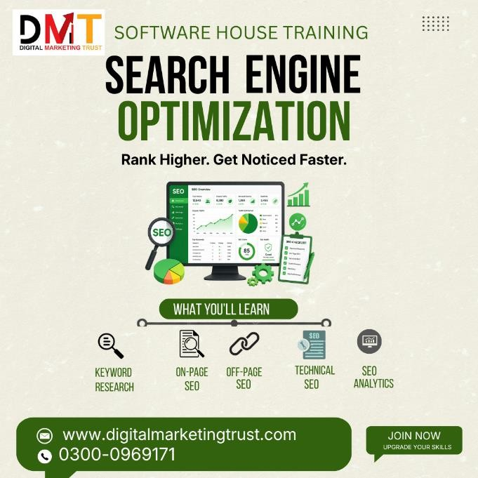
Search Engine Optimization
Search Engine Optimization (SEO) Beginner's Guide
When building your website, you've likely already considered user needs, striving to make it easy for users to find and browse your content. Search engines are also your users; they help other users discover your content. Search engine optimization (SEO) aims to help search engines understand your content and, through search engines, help users find your website and decide whether they should visit it.
Search elements outline the most important elements your website needs to meet to appear in Google search results. While we can't guarantee any particular website will be added to the Google index, websites that follow the search elements guide are more likely to appear in Google search results. SEO revolves around taking the next steps to improve your website's appearance in Google search. This guide will introduce you to some of the most common and effective improvements you can make on your website.
There's no magic formula that will automatically make your website rank number one in Google (sorry!). In fact, some of these suggestions may not even apply to your business, but following best practices will hopefully make it easier for search engines (not just Google) to understand, crawl, and index your content.
How Google Search Works
Google is a fully automated search engine that uses programs called crawlers to continuously browse the web, looking for web pages to add to its index. Typically, you only need to publish your website online; nothing else is required. In fact, the vast majority of websites listed in Google search results are

Slide 2

automatically found and added by Google during its crawling process. For more information, please refer to our documentation on how Google discovers, crawls, and presents web pages.
How long will it take for me to see the effects in search results?
All your changes take time to be reflected on Google. Some changes may take effect within hours, while others may take months. Generally, you may need to wait a few weeks to evaluate whether your work has a beneficial impact on Google search results. Note that not all changes made to a website will have a noticeable impact on search results; if you are not satisfied with the results and your business strategy allows, try implementing the changes iteratively to see if it has an effect.
Helping Google Find Your Content
Before actually doing anything mentioned in this section, check if Google has found your content (or perhaps you don't need to do anything!). Try searching for your website on Google using the `DMT` operator. If you see results pointing to your website, it means your website is indexed. For example, searching DMT` will return these results. If you don't see your website, check the technical requirements to ensure there are no technical reasons why your website is not appearing in Google search before returning here.
Google primarily finds web pages through links from other crawled pages. In many cases, these websites are other websites

